Slide 1
{{STATENAME}}
Varsity high
school RUGBY
our olympic dream:

Slide 2
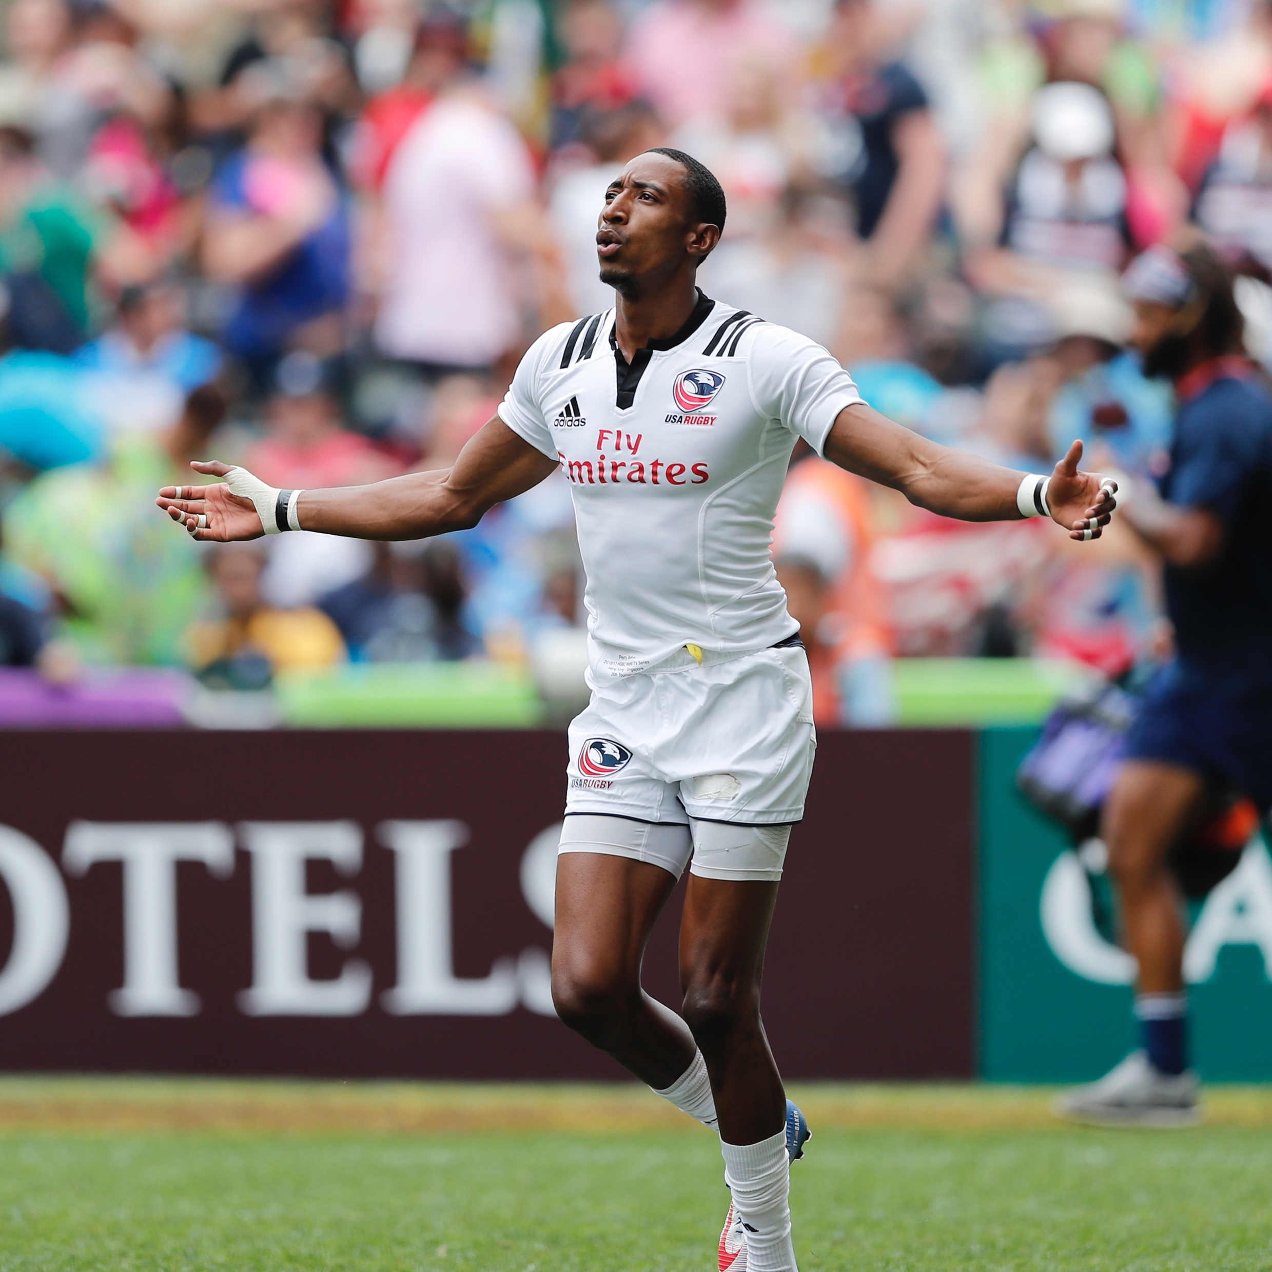
Pillars for success
STATE ORG NAME High School Rugby
USA Rugby Support
{{STATE ORG NAME Support}}
SAFETY
Referee Training
Coach Education
Notes:
Dropping out of youth sport and physical activity continues to be a concern, especially since a majority of youths seem to withdraw during the middle school years. The structure, emphasis on competitive results, length of season, and commitment, along with boredom, are typically cited as primary reasons.

Slide 3
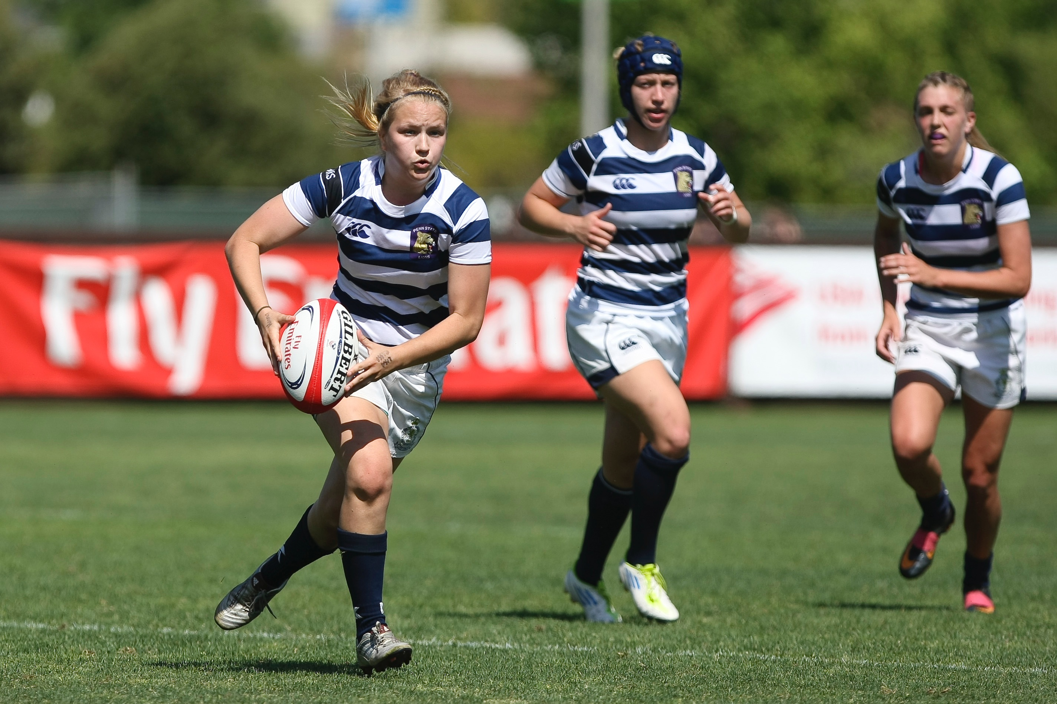

rugby?
what is
A team game played with either 7 v 7 or 15 v 15. Both are played commonly at the high school level.
Players move downfield by running with the ball, kicking, or passing backwards to teammates away from defenders.
Play in rugby is continuous after tackles and only stops at scores, infractions, or going out of bounds.
All players play both offense and defense, much like basketball.
Rugby is played on fields no larger than 100 meters in length by 70 meters in width, with football fields being a common location and size for high school rugby

Slide 4
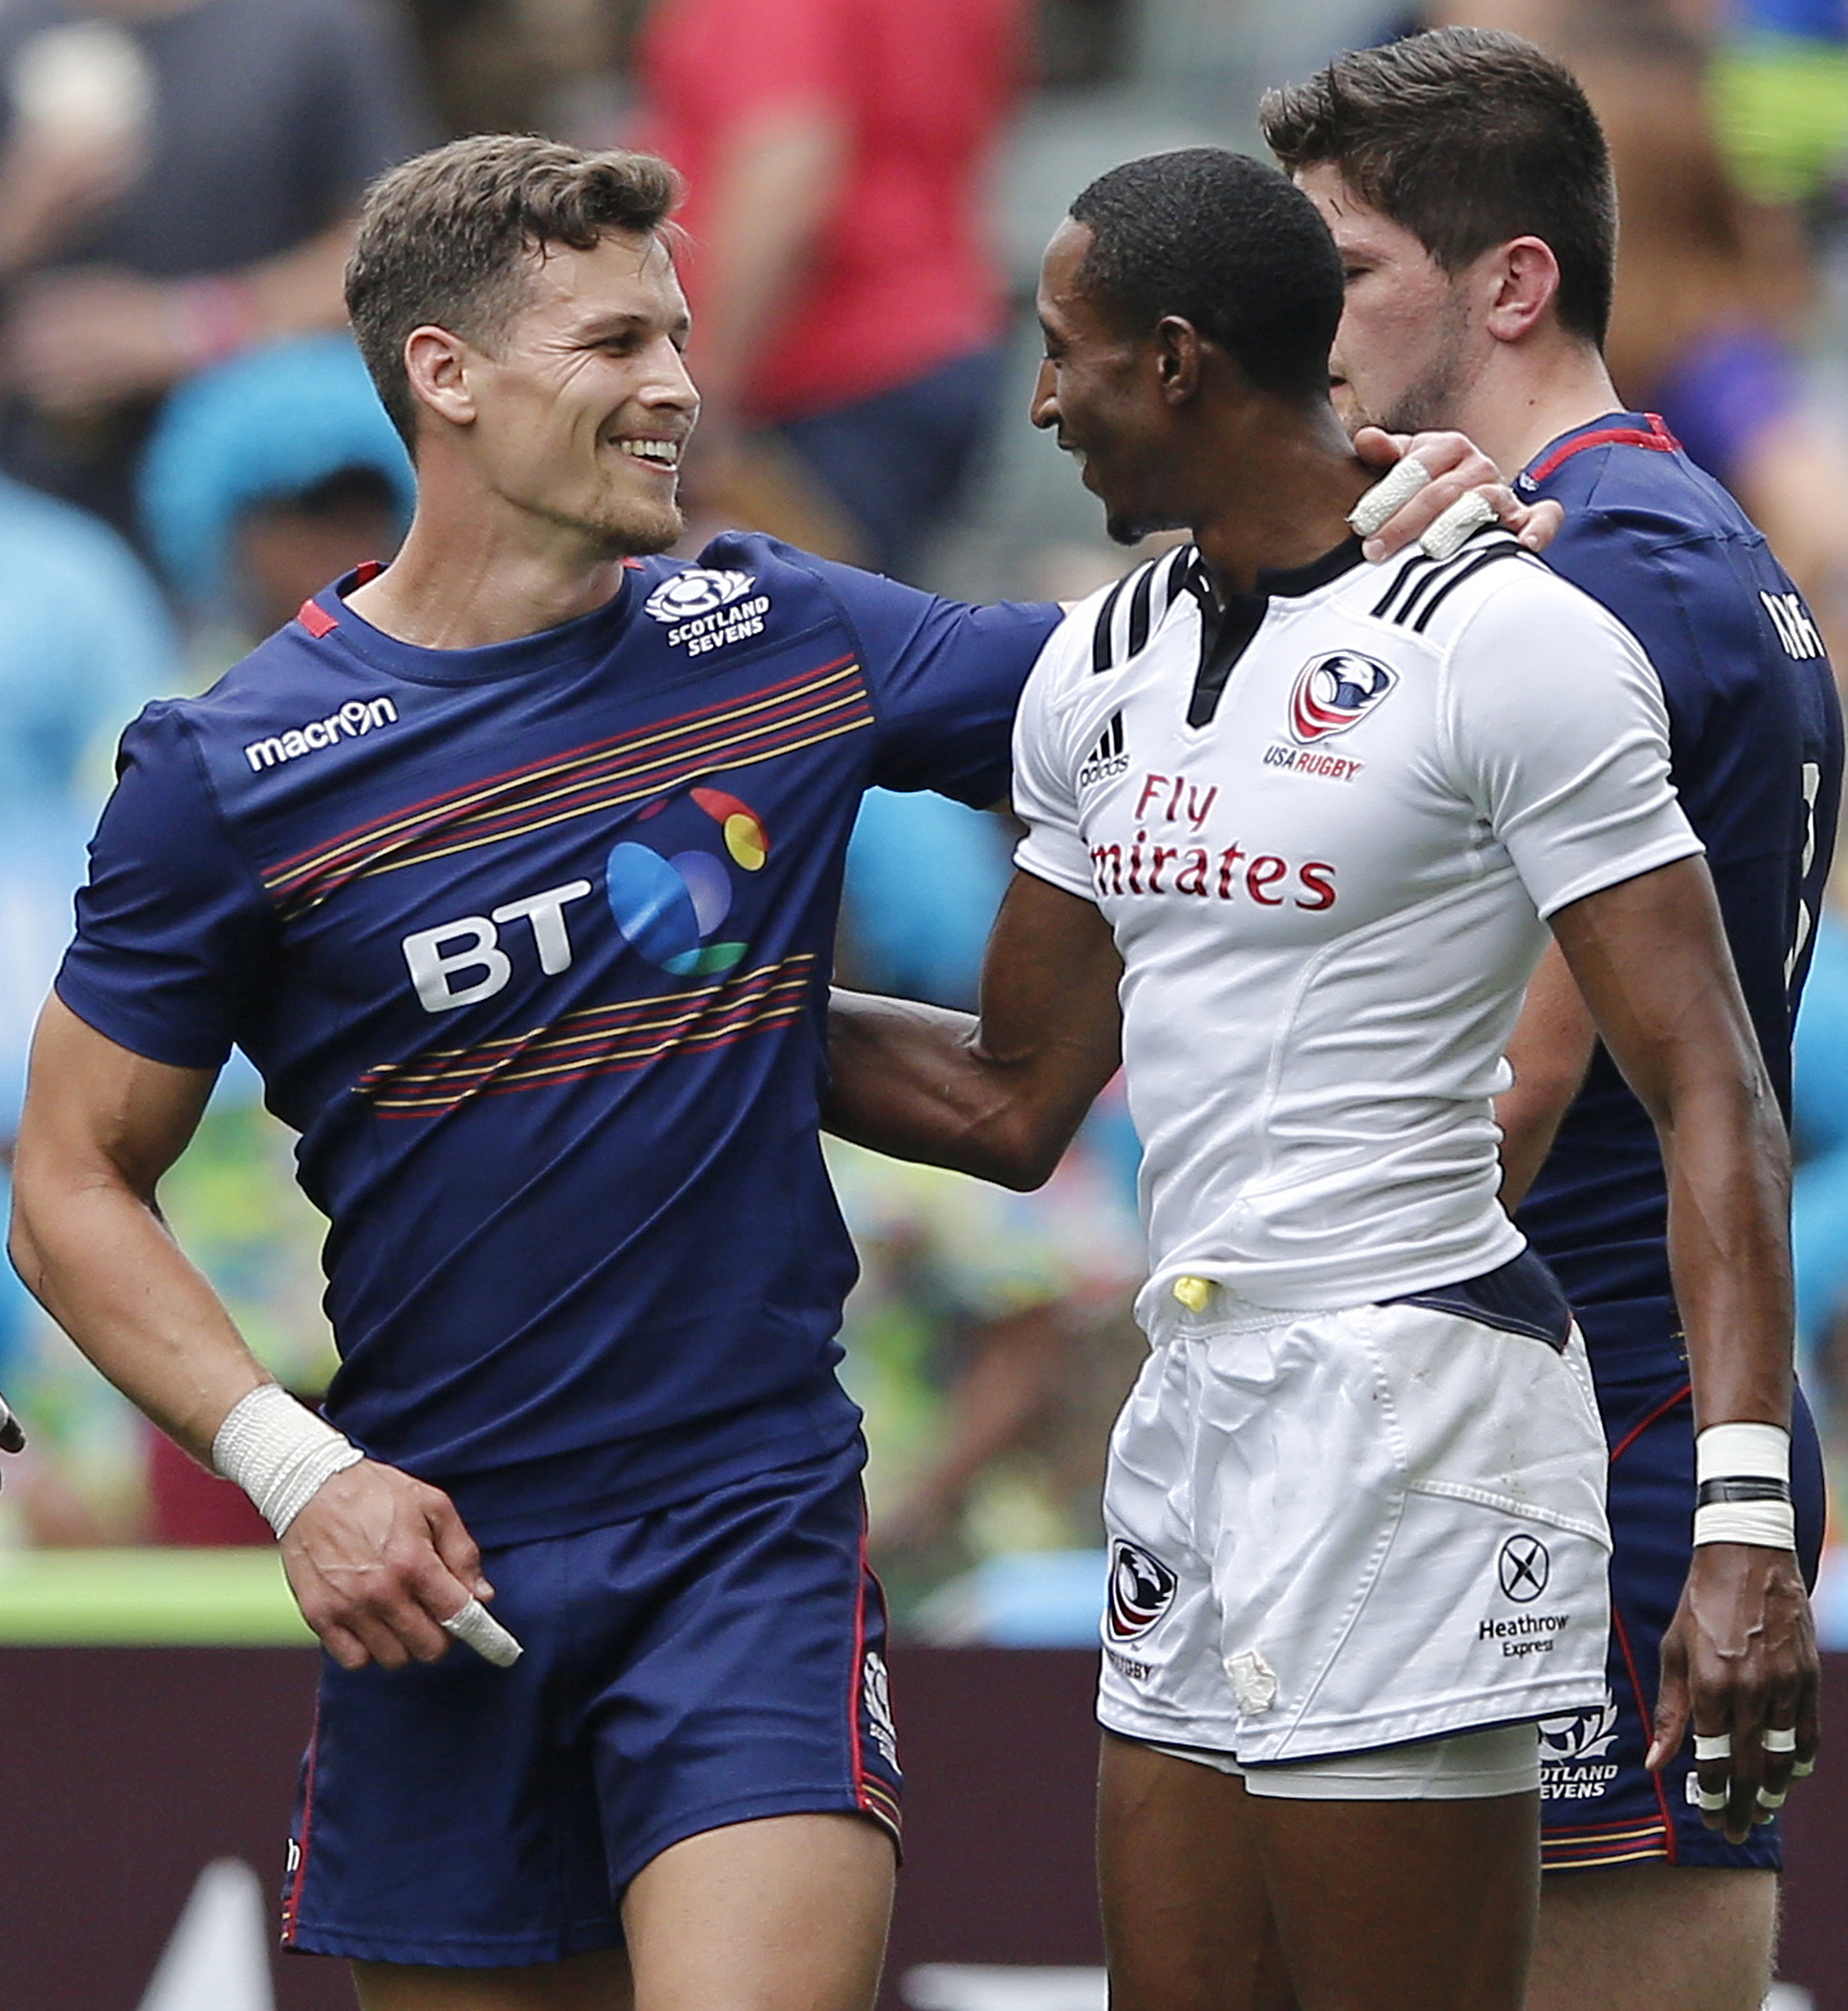
why rugby?
Athlete Benefits:
Emphasis on continuous activity and teamwork
Promotes health and wellness for a team or physical education classes
Teaches good sportsmanship and respect for self and others
Provides an opportunity for cultural education
Students involved in athletics perform better academically
Provides adult support for at-risk kids
Unique, easy to learn, and safe, and fun!
School Benefits:
Extremely low cost while being revenue generating
Easy to implement
Instructional support available
Creates a very flexible program
Requires limited equipment and is easy to set up
Strong, positive sports message for student-athletes
Provides cultural education opportunities

Slide 5
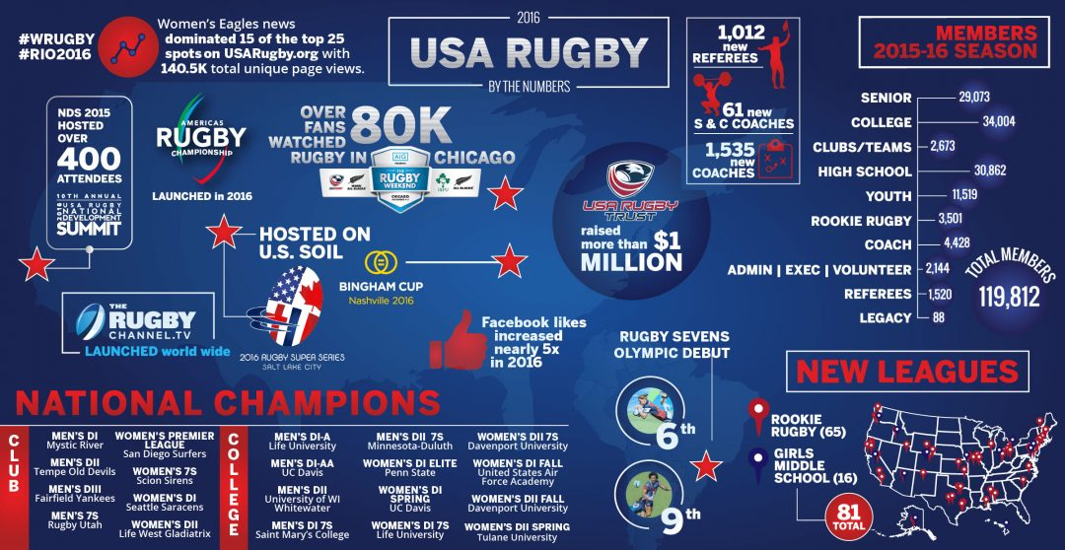
rugby in America, Building Demand

Slide 6
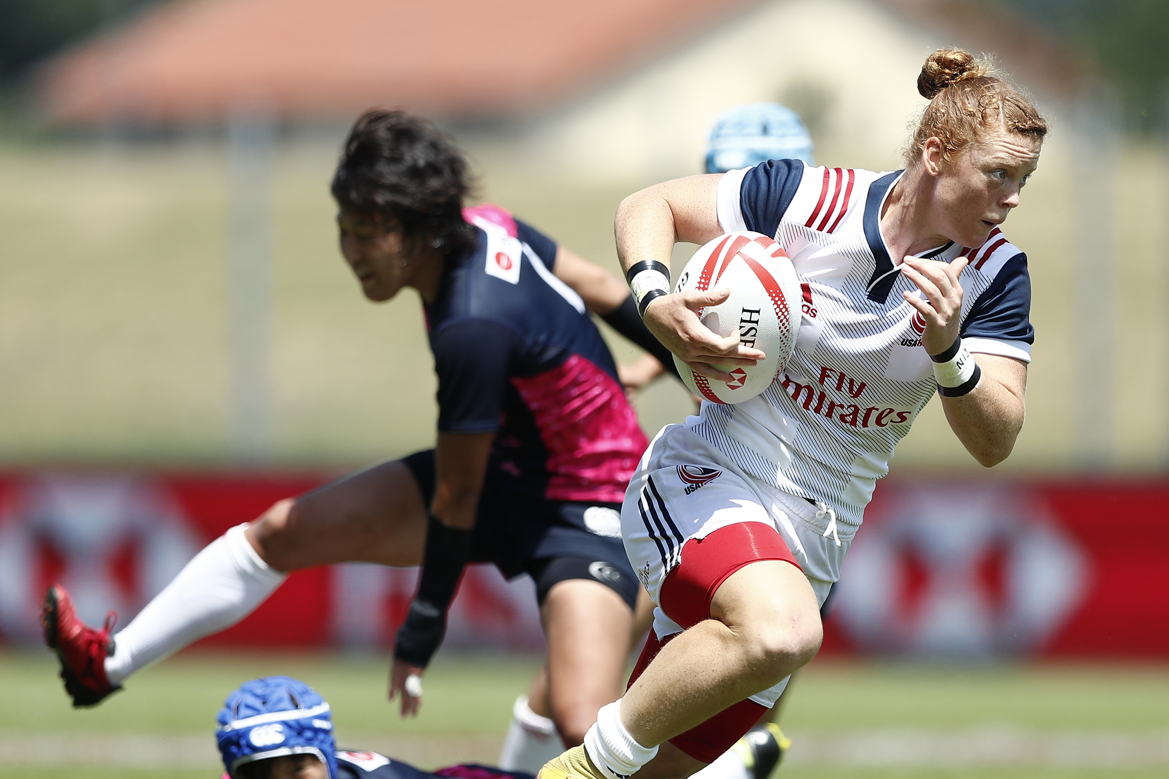
Coaches and
Referees
USA rugby
All USA Rugby registered and certified coaches and referees receive the following education/training:
Rugby injuries comparable to other common sports like soccer and football. For more information on safety in rugby visit www.usarugby.org/medical
Full Background Screening
Concussion Management
Sexual Abuse, Bullying and Harassment Prevention and Awareness
Rugby Technique Instruction
Ethics and Sportsmanship

Slide 7
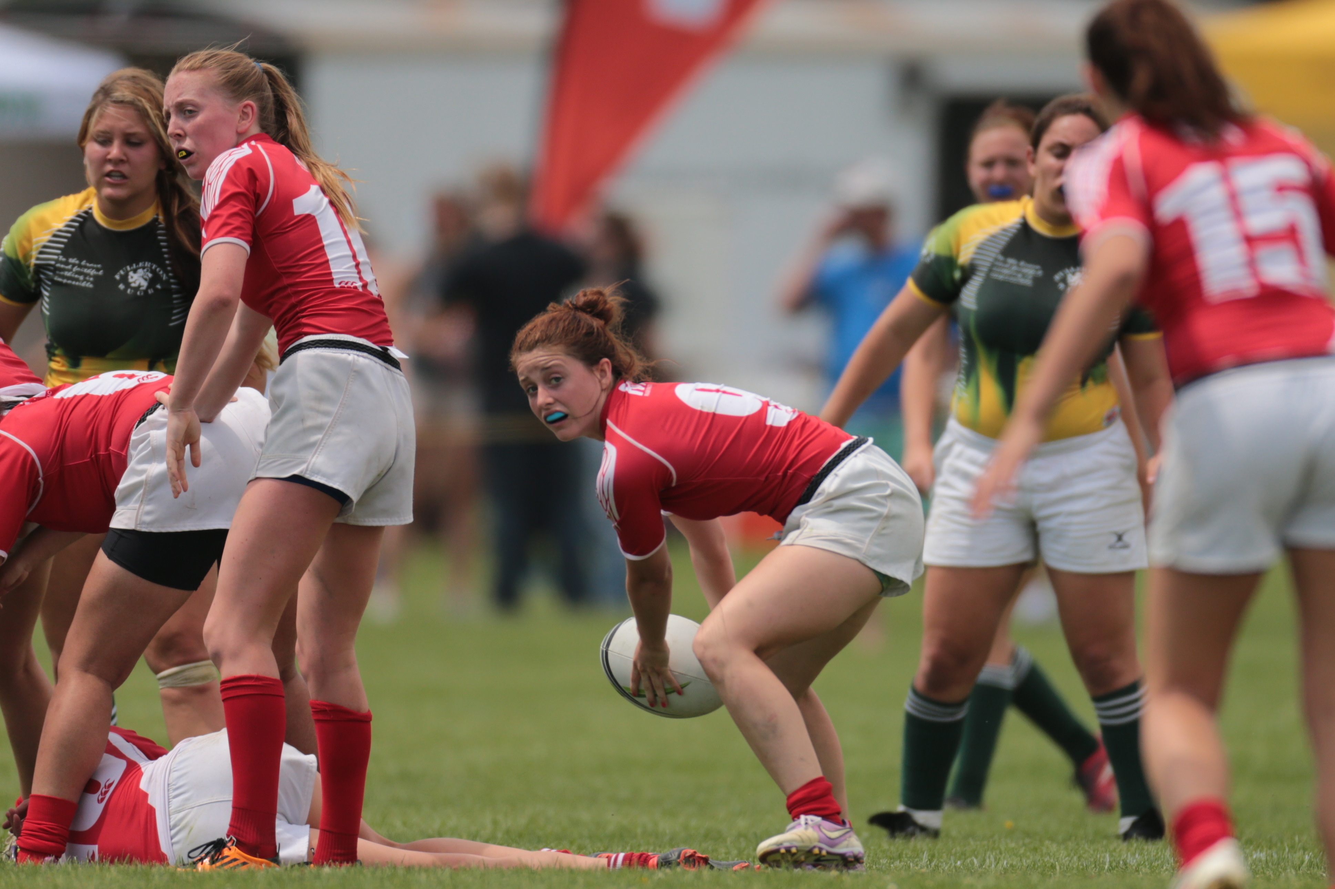
Rugby as an Opportunity
Rugby is now a varsity sport for many colleges and universities across America.
Nationally, there are 900 higher education campuses with rugby teams, many are varsity and several give scholarships.

Slide 8
Olympic Dreams
USA rugby
2016 marked the first year the Olympics featured rugby since 1924! The sport will continue to be in the Olympics and we need your students to ensure we win gold!

Slide 9
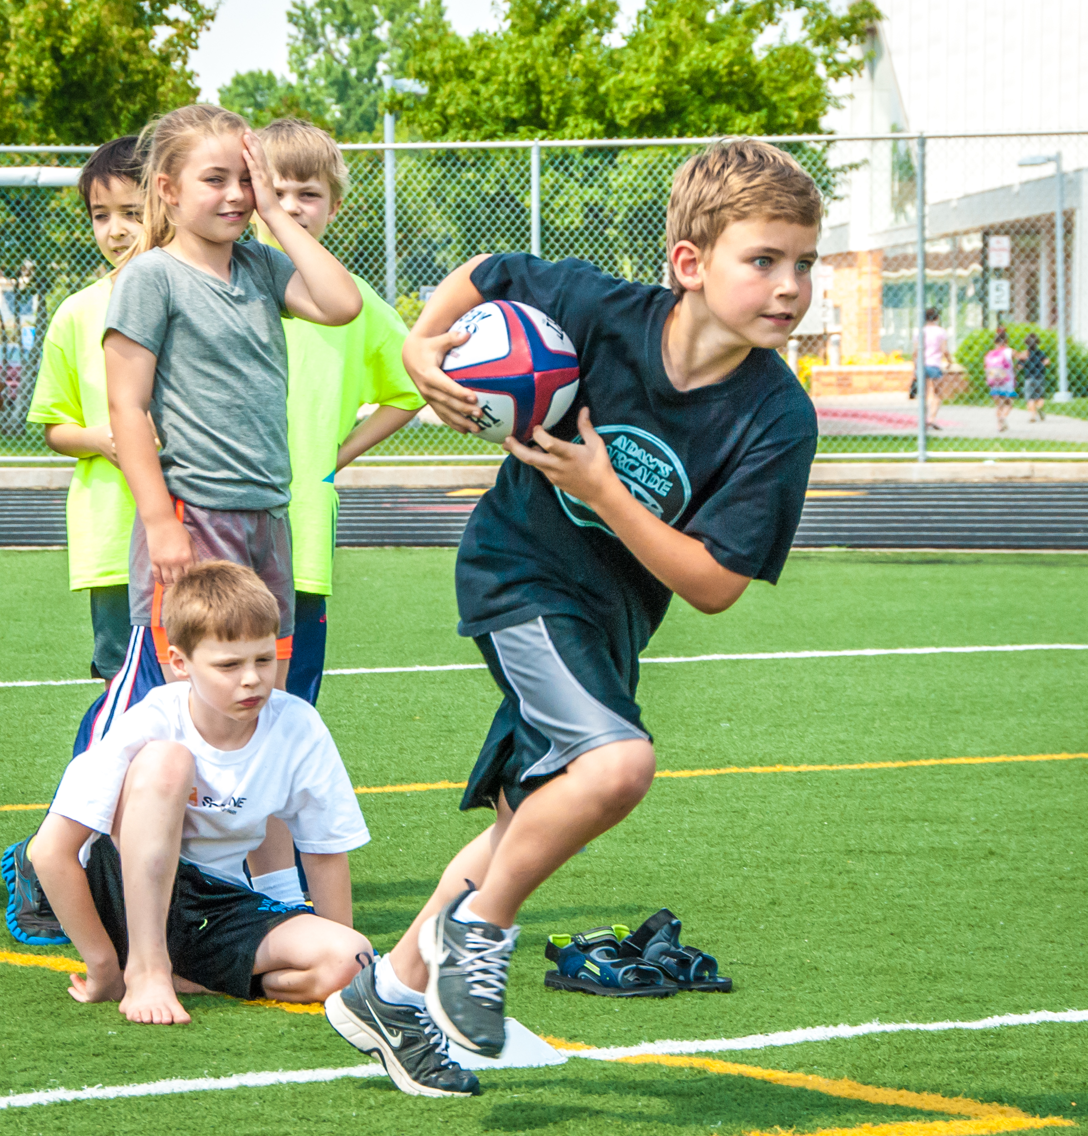

Getting started
Utah Youth Rugby Rugby visits your school’s PE classes, offering curriculum at no cost
Interest is built and viability proven
Coaches are trained and equipped.
Boys and Girls teams are offered and scheduled within conference
Notes:
Parents wont take a chance on a new activity that is 12 weeks long!
Practices add a night of headache for parents and kids hate practicing and love games

Slide 10
How we SUPPORT YOU:
Running rugby in the PE classes at NO COST to the schools
Training and education for the teachers involved. A specific training will be held for your schools.
Link your school up with trained rugby coaches to mentor your program.
Provide your initial set of equipment for both PE classes and the new teams, including rugby balls, cones, and curriculum.
What we need from you:
A link into your PE programs to offer free rugby curriculum
Access to school facilities for practices and matches. Additional liability and facility insurance is provided through USA Rugby.
Costs average $50-$100 per player to cover referees, league fees, etc. A normal uniform cost is $30-$50 a player (about the same as soccer)

Slide 11
Fast Facts:
Rugby is comparative to boys soccer for injury rates. We have a low occurrence of concussion and require all our coaches and referee to be concussion trained.
High School Rugby is played in halves, play is 35 minute halves with a 5 minute half time
Rugby can be played on a football field size field or a soccer field. Either works and is within regulation.
A normal rugby team has either 15 players on the field with 8 substitutes for each match or 7 players on the field with 5 substitutes.
Rugby is the LARGEST sport for girls with 30+ on a team (helping with Title IX), the ONLY contact tackle sport for girls, and has the SAME rules, field size and ball size as the boys game. This makes it very easy to host both a boys and girls team at your school.
Rugby fills high school football stadiums in several communities, turning that empty facility into a revenue generator in the spring!

Slide 12
About USA RUgby
USA Rugby is the National Governing Body for the sport of rugby in the United States.
Full sport member of the US Olympic Committee
USA Rugby was presented the International Rugby Board’s Development Award in 2011 for efforts to grow the game at the youth and high school level in America for their Rookie Rugby program.
Support the growth of the game at all levels, especially in our schools.
usarugby.org
About UTAH YOUTH Rugby
Governing body for youth and high school rugby in the state of Utah
Incorporated in 2010, we have grown to over 2,000
Administration structured to support rugby at high schools
utahyouthrugby.org

Slide 13
